Slide 1



SMART INDIA HACKATHON 2026
VETNEXA
  Problem Statement ID – SIH26128
  Problem Statement Title - Efficient system for early detection, prevention and management of livestock diseases and animal health issues.
  Theme - MedTech / BioTech / HealthTech
  PS Category - Software
  Team ID- 192212
  Team Name - VETNEXA

Slide 2
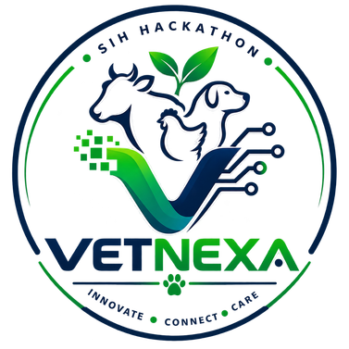


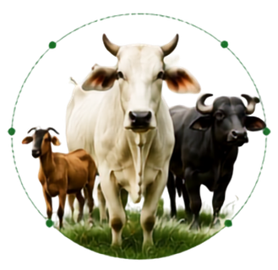





VETNEXA
AI Powered Livestock Health Intelligence System
PROPOSED SOLUTION
OUR SOLUTION AT A GLANCE
VETNEXA is an AI-powered platform for early detection, prevention and management of livestock diseases and animal health issues. It combines symptoms, animals images, health history and data-driven insights to support farmers and veterinarians.
HOW IT ADDRESSES THE PROBLEM
AI Symptom Analysis
Alerts & Reminders
1
2
3
4
5
Animal Data
AI Analysis
Risk Result
Action
Expert
Support
Symptoms + Image + History
Multi-Model Assessment
Disease / Risk Level
Advice + Alert + Reminder
Image-Based Disease Detection
Veterinarian Consultation
Veterinarians Follow Up
INNOVATION AND UNIQUENESS OF THE SOLUTION
Multi-Model AI
Individual --> Herd Intelligence
Farmer + Veterinarians Workflow
Regional Language Assistant
Symptoms + Image + History for a richer assessment.
Preventive Care & Vaccination
Health Monitoring & Analytics
Animals-level data can reveal herd patterns and early outbreak signals.
Healthier Animals, Stronger Farmers, Sustainable Future
AI-Assisted assessment connects to consultation and follow-up.
Voice/Chat interaction for easier farmer access.

Slide 3















FEASIBILITY ANALYSIS
Can we build it? Is it practical and sustainable?
Feasibility
Can we build it?
Challenges & Risks
What could go wrong?
Strategies to Overcome
How do we solve it?
Technical
Tech available & cost-effective
Limited Internet
Connectivity in rural areas
Offline-First App
Works offline, syncs later
Operational
Easy to use(Farmer & vets)
Data Quality
Insufficient or imbalanced data
Better Data Collection
Multiple sources + augmentation
Economic
Low cost, open-source
Low Adoption
Resistance by farmers & vets
User – Centric Design
Simple UI, Local language, Training
Legal
Compliant with data &
animal welfare norms
Privacy & Security
Risk of data breaches
Secure & Compliant System
End – to - end encryption, follow guidelines
Sensor Reliability
Sensors may fail in harsh environments
Rugged Hardware &
Monitoring
Low – power devices, real – time alerts
Schedule
MVP ready in hackathon timeline
Viable Solution
A practical, scalable and sustainable solution
for animal healthcare

Slide 4
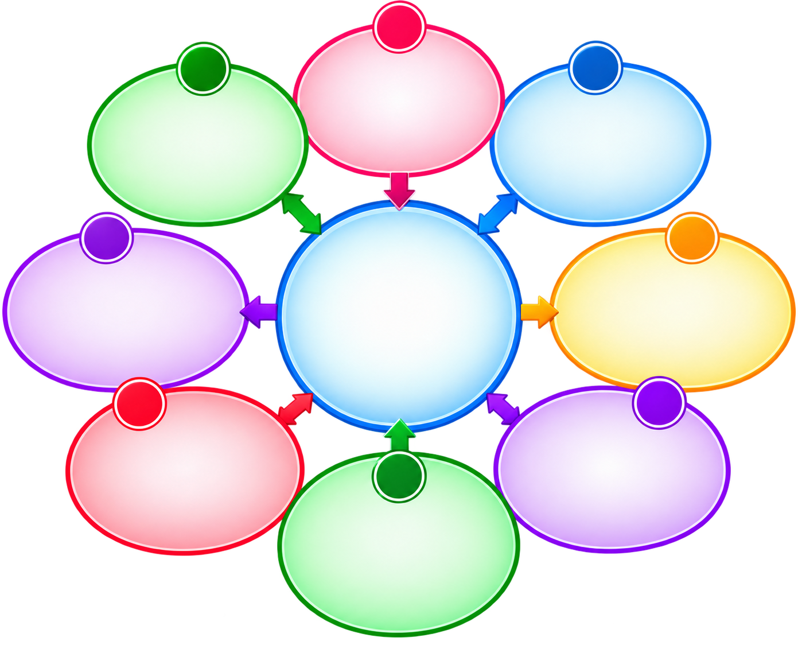










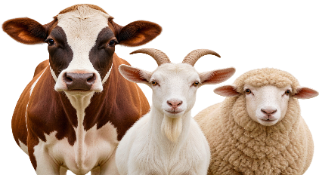















TECHNICAL APPROACH
Smart Technology. Healthy Livestock. Stronger Future
1
TECHNOLOGY TO BE USED
Farmer / User​
Upload animal image ​
Enter details ​
Get instant result
8
2
Programming Language
HTML5, CSS3, JavaScript
VETNEXA Website​
User friendly interface ​
Upload image / data ​
View results & history
Database &
Monitoring​​
Store animal data ​​
Health history ​​
Alerts & reports ​​
Track progress
Frontend
React.js (Web Interface)
Backend
Node.js (Server – Side application)
API
Express.js (REST API and communication)
7
VETNEXA
3
Database
MongoDB (Animal profile, health records, cases)
Recommendation
Engine​​
Symptoms ​​
Treatment
Prevention
Advisory / Care tips ​​
Smart Animal Healthcare​​
Image Preprocessing​
Resize
Crop ​
Quality check ​
Normalization ​
AI/ML
Python (AI/ML development)
Deep Learning
TensorFlow / Py-Torch (Disease prediction model)
Image Processing
OpenCV (Image preprocessing and analysis)
Healthier Animals​​
Brighter Tomorrow​​
6
4
AI Model
CNN / Transfer Learning (Livestock disease classification)
ML Model​
Disease classification ​
Analyze image ​
Confidence prediction ​
Confidence score
Veterinarian
Verification​​
Expert review ​​
Confirm diagnosis ​​
Suggest treatment ​
Authentication
Firebase Authentication (Secure farmer / veterinarian login)
5
Storage
Firebase Storage / Cloud Storage (Store uploaded animal images)
Confidence Check​
High confidence → Predict ​
Low confidence → Re-check ​
Ensure accuracy ​
Deployment
Firebase / AWS / Render (Hosting and deployment)
Camera
WebRTC / get User Media (Real – time image capture)
Notification - Firebase Cloud Messaging (Health alert and notifications)

Slide 5














IMPACT AND BENEFITS
Healthier Animals. Prosperous Farmers. Stronger Nation.
TARGET AUDIENCE
POTENTIAL IMPACT ON THE
TARGET AUDIENCE
BENEFITS OF THE
SOLUTION
Farmers & Diary Owners
SOCIAL BENEFIT
Get early alerts, guidance and better herd management
EARLY DISEASE
DETECTION
INCREASED
PRODUCTIVITY
Better animal health ensures food security and improves rural livelihood.
Detect diseases early
and take timely action, reducing spread
and mortality.
Healthy animals
lead to higher milk production, growth and performance.
Veterinarians
Quick diagnosis support, case tracking and consultation.
ECONOMIC BENEFIT
BETTER ANIMAL
HEALTH & WELFARE
REDUCED ECONOMIC
LOSSES
Increased productivity and reduced losses lead to higher income for farmers and businesses.
Government & NGOs
Improves overall health, productivity and quality of life for animals.
Prevents outbreaks. reduces treatment costs and minimizes financial losses.
Monitor disease outbreaks and plan effective interventions.
ENVIRONMENTAL
BENEFIT
Promotes sustainable livestock management and reduces unnecessary use of medicines
Livestock Businesses
REAL TIME ALERTS &
RISK MITIGATION
INFORMED
DECISION MAKING
Reduce losses, improve productivity and ensure better animal welfare.
Data - driven insights help in better planning and resource management.
Instant alerts and risk mapping help in taking preventive measures and control outbreaks.
NATIONAL BENEFIT
Strength livestock sector, contributes to rural development and supports Aatmnirbhar Bharat.

Slide 6


RESEARCH AND REFERENCES
Knowledge. Innovation. Impact
RESEARCH BACKGROUND
Livestock diseases cause major economic losses and threaten food security. Early detection, continuous monitoring and timely interventions can significantly reduce losses and improve animal productivity. Our solution leverages AI, IoT and data analytics to provide intelligent health management for livestock.
REFERENCES AND RESEARCH WORK
Food and Agriculture Organization (FAO) - Animal Health
https://openknowledge.fao.org/server/api/core/bitstreams/9acc7045-780e-4819-8a1e-f999ca4f7107/content
OIE - World Organisation for Animals Health
https://www.woah.org/app/uploads/2026/05/sowah26-english-digital-v4-single-pages-opt-vf.pdf
IoT based Smart Livestock Health Monitoring System International Journal of IoT and Applications
https://ijircce.com/admin/main/storage/app/pdf/70_Smart%20Livestock%20Health%20Monitoring%20and%20Tracking%20System%20Using%20IoT%20and%20Real-Time%20Analytics.pdf
Deep Learning for Image-based Animal Disease Detection IEEE Access
https://link.springer.com/content/pdf/10.1186/s40537-024-01057-7.pdf
6

